Slide 1
Smalltalk
The Language That Shaped Modern Computing
Group Member: Lesley, Karley, Jonathan, Jiao
Course：CSCU9Y4 — Stirling College, ChengDu University
1 / 15

Slide 2

Presentation Overview
1
2
History & Background
Core Concepts & Modern Comparison
3
4
Impact & Applications
Learning Experience & Live Demonstration
Each section approximately 2.5 minutes
2 / 15

Slide 3

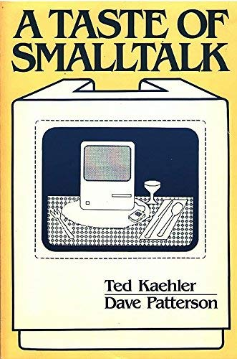
Origin of Smalltalk
Smalltalk was developed by Alan Kay and others at Xerox PARC in 1972 and is the first object-oriented programming language in history. The original vision was to create a computer language for children of all ages that would make programming intuitive and natural. After several iterations, Smalltalk gradually evolved from an educational tool into a highly influential industrial-grade language.[1]
"The best way to predict the future is to invent it." — Alan Kay[2]
3 / 15

Slide 4
Smalltalk's Transformative Journey
From its conceptual inception in 1967 to its commercial release in 1980, Smalltalk underwent three major version updates, each introducing revolutionary innovations.[3]
1967 — Smalltalk-72
1
Introduced the fundamental concepts of object-oriented programming, laying the foundation for the entire paradigm
2
1976 — Smalltalk-76
Introduced a bytecode VM and a just-in-time compilation mechanism, significantly improving execution efficiency
1980 — Smalltalk-80
3
Become a widely adopted version and officially enter the commercial market
4 / 15

